Slide 1
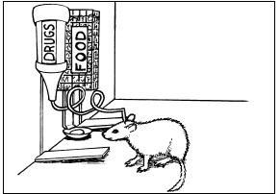
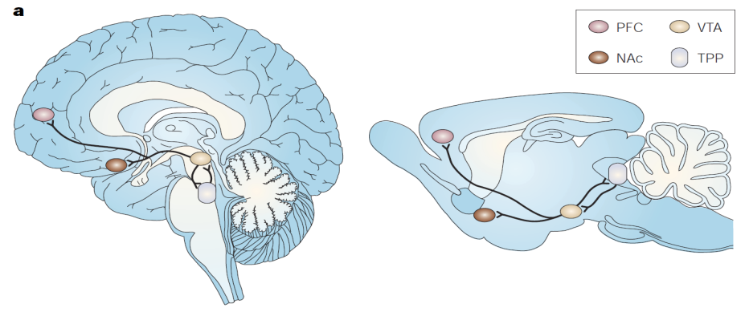
Neurological Disorders Lesson 5.2
How do drugs alter synaptic transmission?
Human Brain
Rat Brain

Slide 2
Do Now:
Addictive drugs increase synaptic transmission in the reward pathway. Brainstorms ways in which drugs of abuse could increase synaptic signaling.

Slide 3
The Brain’s Reward Circuit
Human Brain
Rat Brain
PFC
NAc
VTA

Slide 4
The Brain’s Reward Circuit
Inhibitory
Neuron
Prefrontal Cortex
VTA
NAc

Slide 5
Synaptic Transmission
2. Voltage-gated Ca²⁺ channels open.
Ca²⁺ flows into cell
3. Ca²⁺ sensitive proteins fuse synaptic vesicles to membrane, releasing dopamine into synaptic cleft
4. Dopamine binds to postsynaptic receptors.
Ca²⁺
1. Action Potential in VTA
Dopamine
6. Excess dopamine is pumped back into presynaptic cell.
5. Ion channels open on postsynaptic membrane, allowing ions to flow into cell.

Slide 6
How do drugs of abuse alter synaptic transmission???

Slide 7
Drugs Act at Many Sites in the Brain’s Reward Circuit
Alcohol
Inhibitory
Neuron
Heroin & Morphine
Prefrontal Cortex
VTA
Nicotine
Marijuana
NAc
Cocaine & Amphetamines
Heroin & Morphine

Slide 8
Drugs Have Many Targets in the Synapse
Inhibitory Neuron
Alcohol Heroin & Morphine
Ca²⁺
Dopamine

Slide 9
Drugs Have Many Targets in the Synapse
Inhibitory Neuron
VTA
Nicotine & Marijuana
Ca²⁺

Slide 10
Drugs Have Many Targets in the Synapse
VTA
NAc
Ca²⁺
Dopamine
Cocaine & Amphetamines

Slide 11
What do all the drugs have in common?
Alcohol
Inhibitory
Neuron
Heroin & Morphine
Prefrontal Cortex
VTA
Dopamine
Nicotine Marijuana
NAc
Cocaine & Amphetamines
Heroin & Morphine

